Slide 1


CREATIVE INTERIORS
CREATIVE INTERIORS WEBISTE DEVELOPMENT
By
Rachana K
Althaf S
Sanjay M

Slide 2
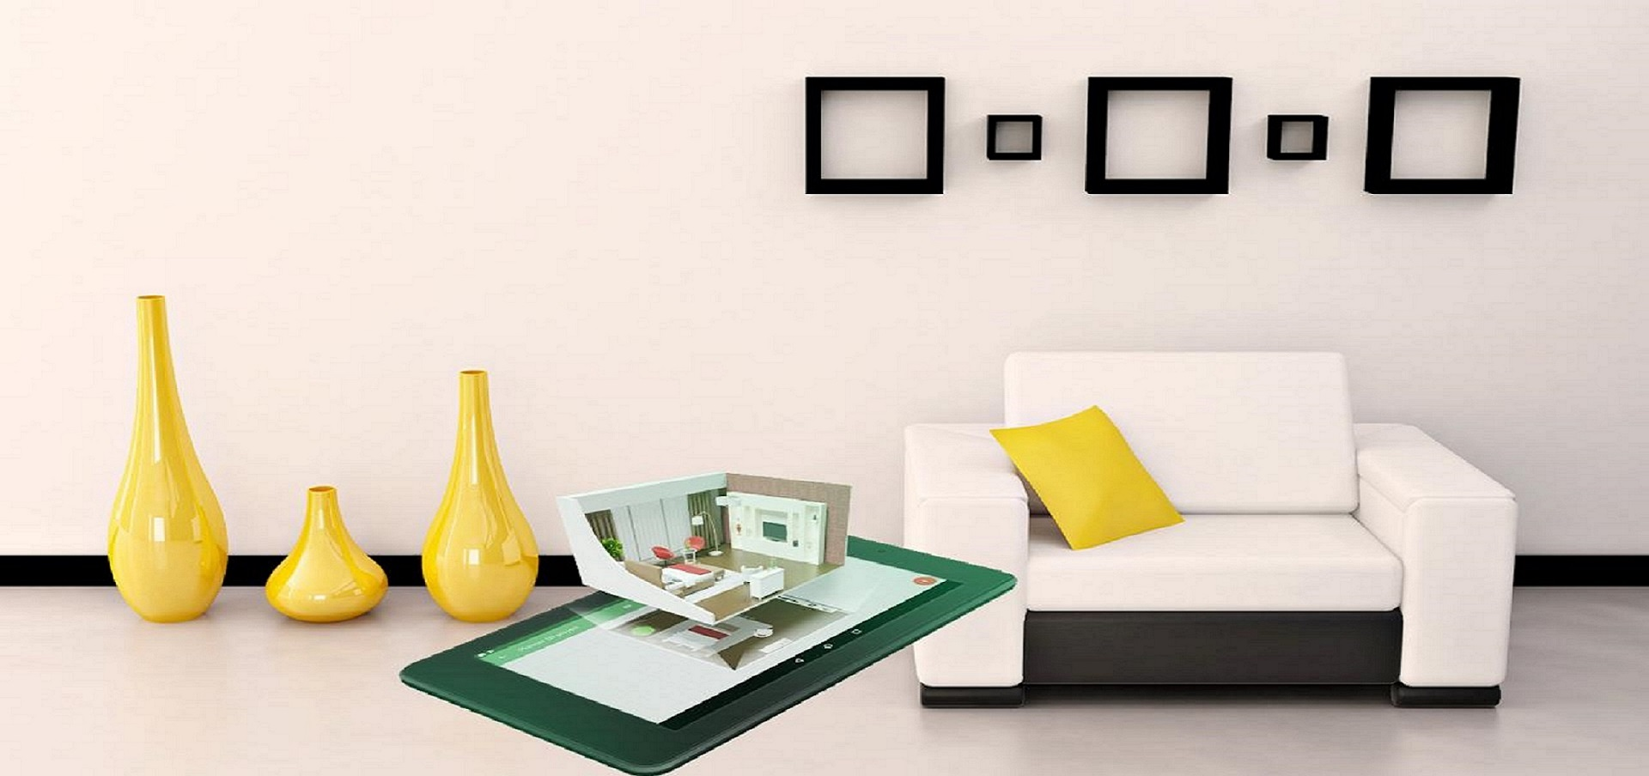
Introduction
Interior design is all about how we experience spaces. It’s a powerful, essential part of our daily lives and affects how we live, work, play, and even heal. Comfortable homes, functional workplaces, beautiful public spaces—that’s interior design at work.

Slide 3
Introduction
This is a website which helps to Explore various Interior Design styles on your finger tips. You can choose your best matched interior design and contact us to implement the same. We are Launching this website with new brand name called," Creative Interiors. "
We have developed Eight Web Pages as follows,
Home page
About section
About Us Page
Meet Our Team Page
Services
Residential Interior designers Page
Commercial Interior designers Page
Office Furniture Page
Home Renovation Page.
Contact Page

Slide 4

Why Interior Designers wear?
Interior designers are experts in creating more spaces, improving the space efficiency, improving the functional usage of space, improving the lighting effect, improving the color effects, improving the textures, patterns, scale, size etc. ... Hence interior design is much important than it seem.

Slide 5
Have a look of our website pages…..
CREATIVE INTERIORS

Slide 6
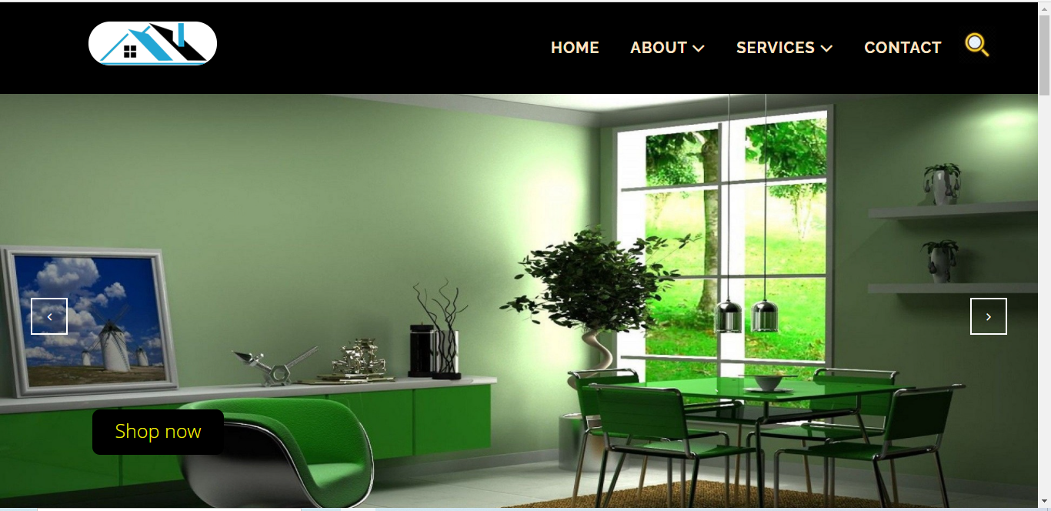
Home page
Shows carousal and header part

Slide 7
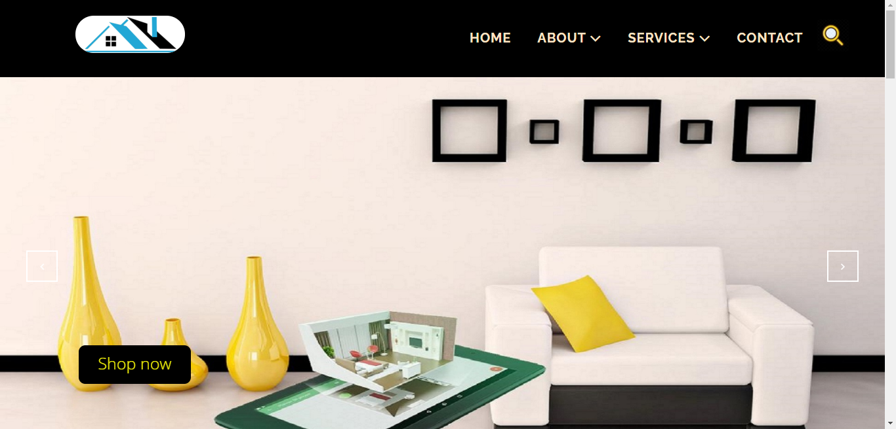
Home page
Shows carousal and header part

Slide 8
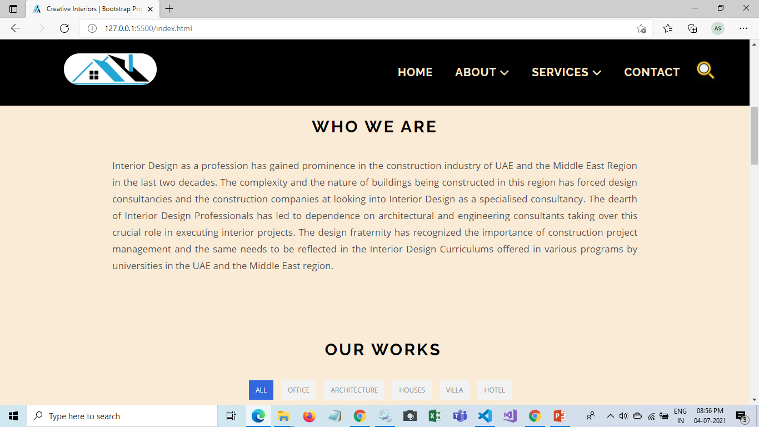
Home page
Shows body middle shopping part

Slide 9
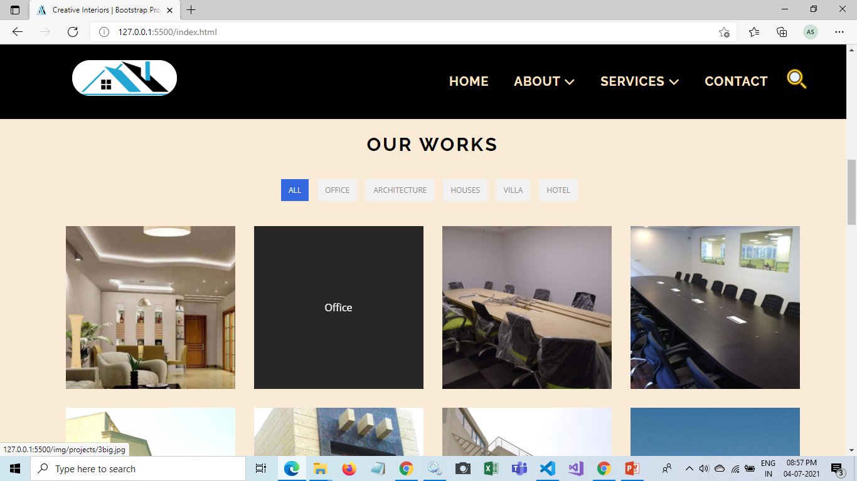
Home page
Shows section three of the home page

Slide 10
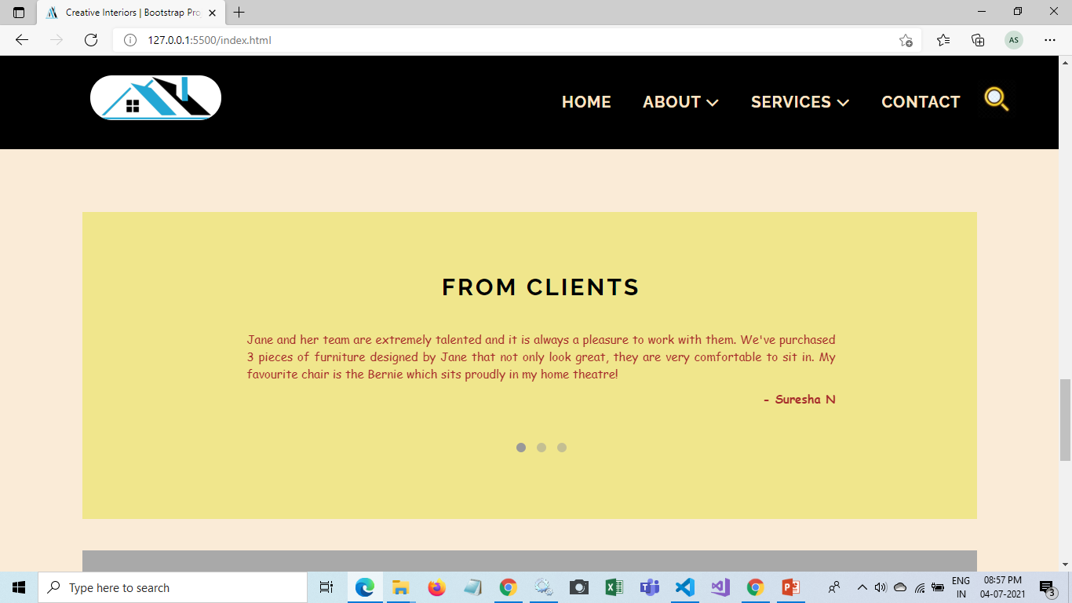
Home page
Shows section Four of the home page

Slide 11

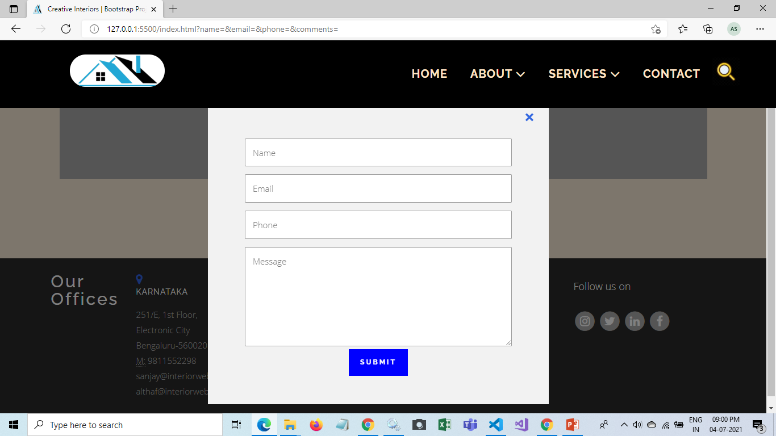
Home page
Enquiry Now From
Shows section Fifth of the home page

Slide 12
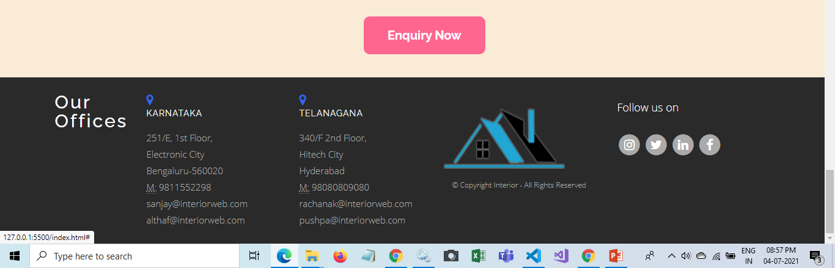
Home page
Shows footer part

Slide 13

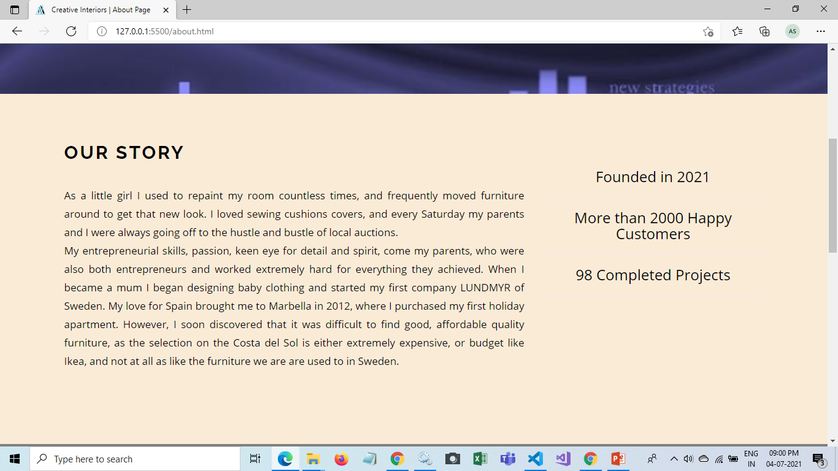
About Us page

Slide 14
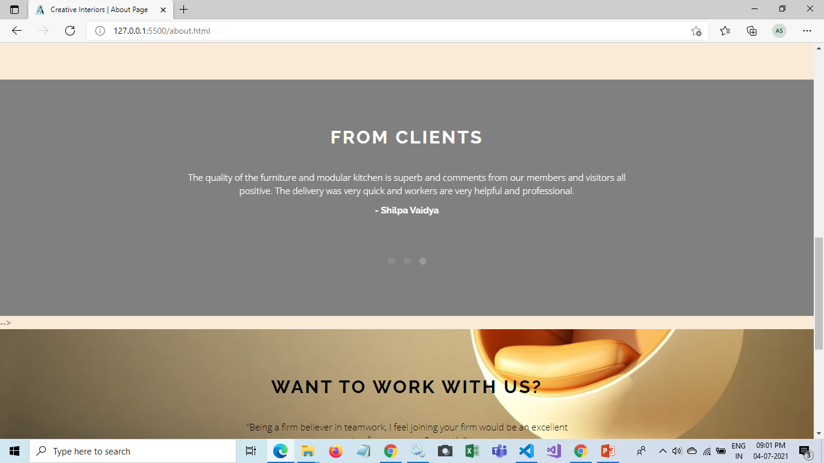
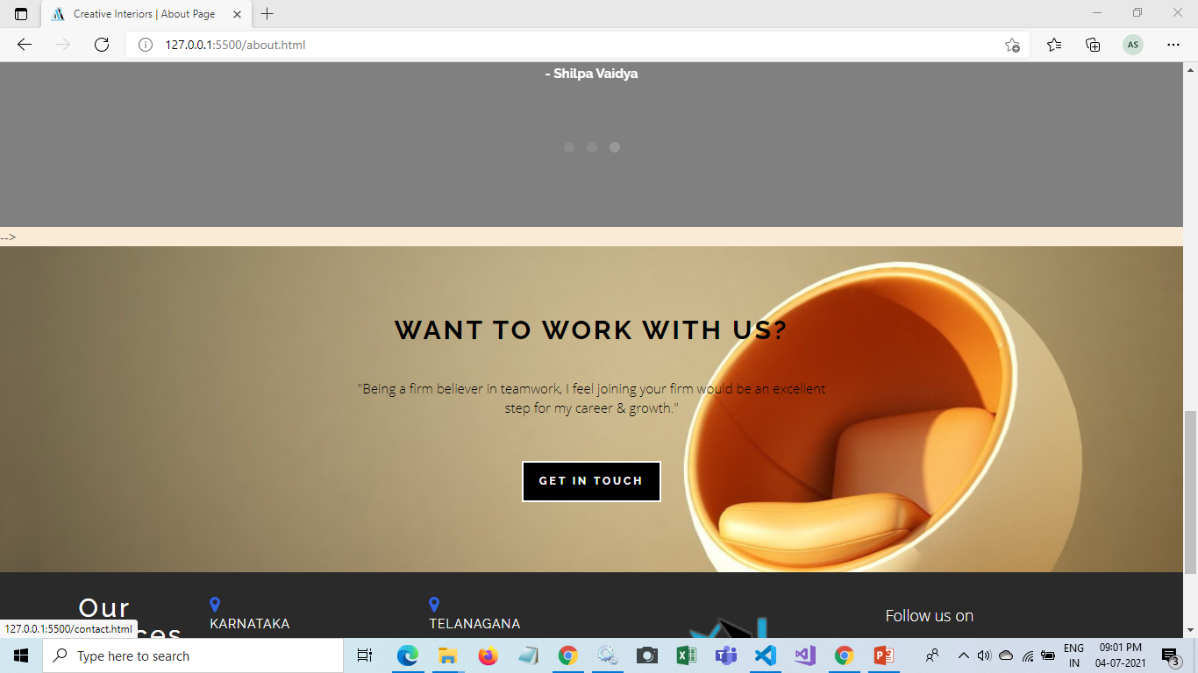
About Us page

Slide 15
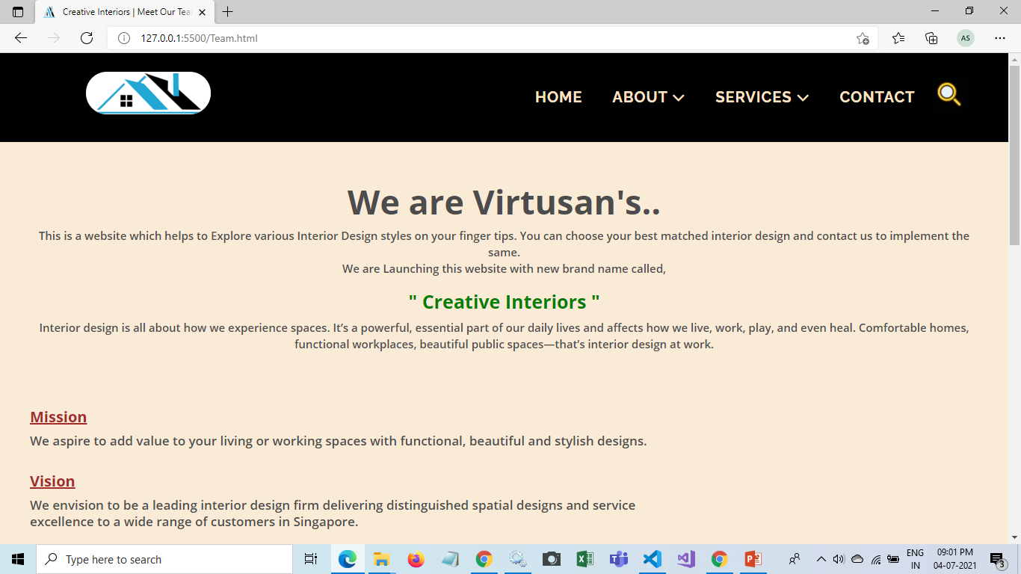
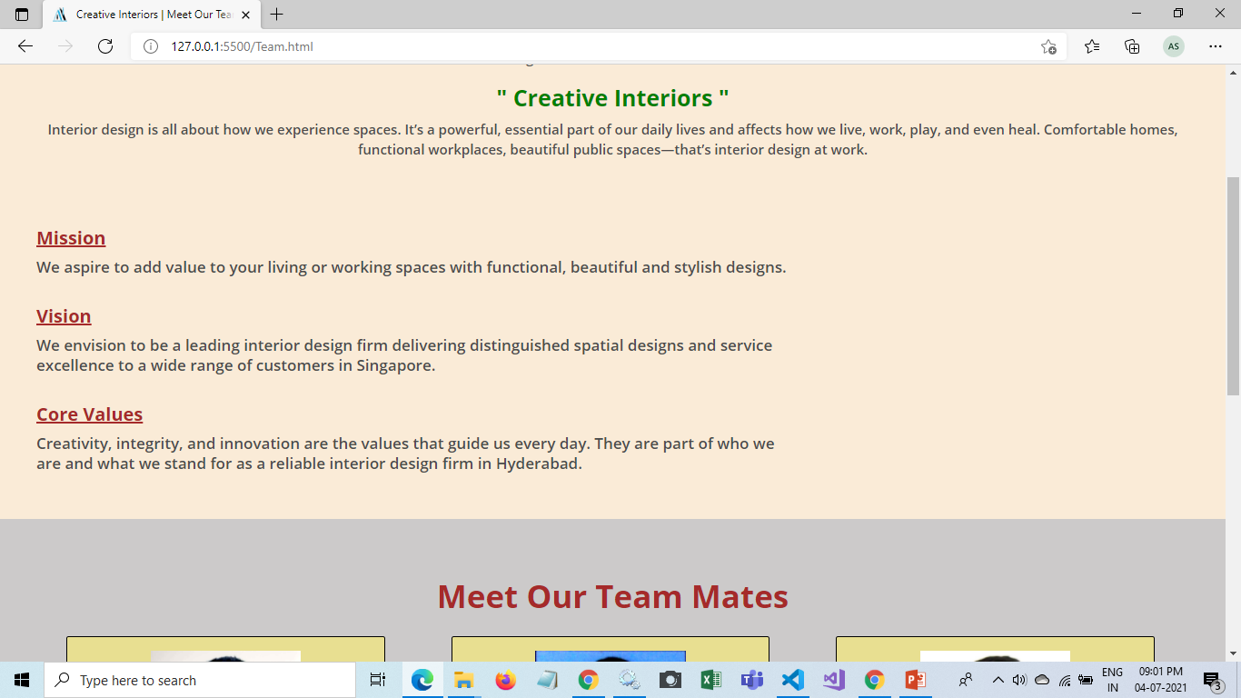
Meet Our Team page

Slide 16
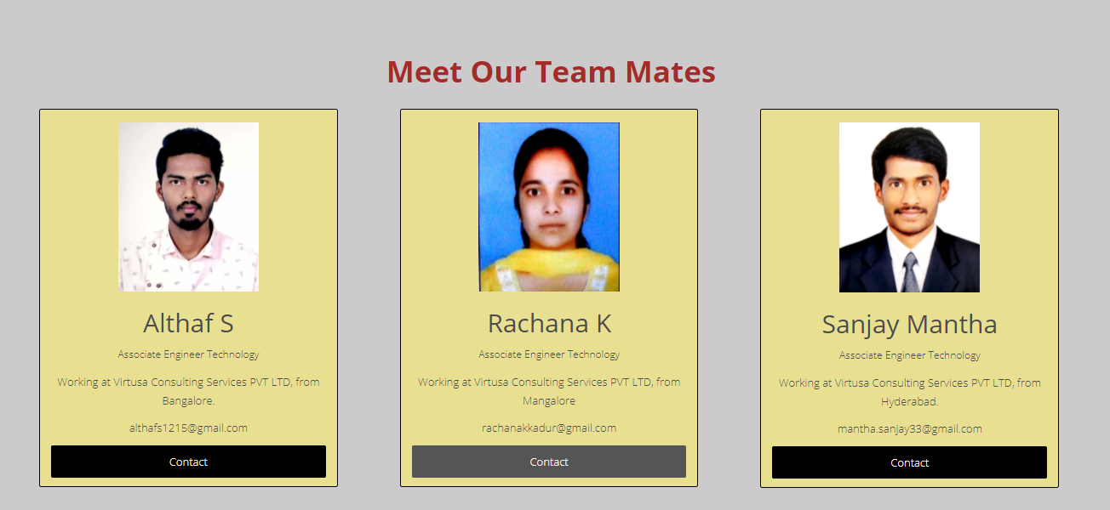
Meet Our Team page

Slide 17
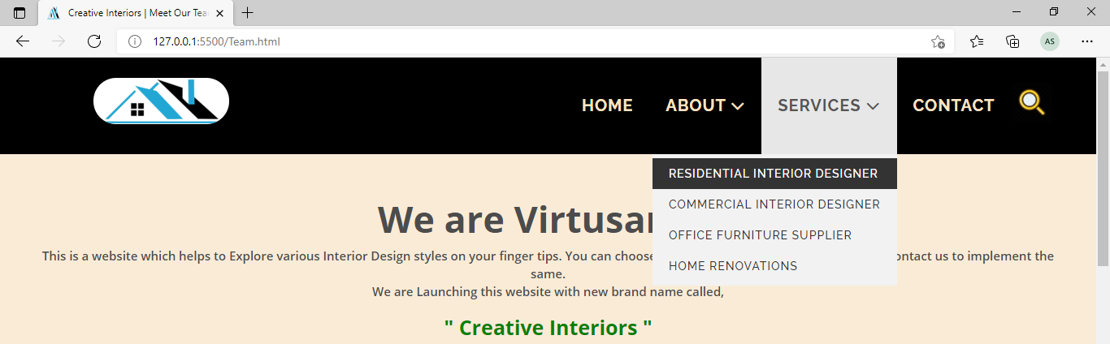
Services page

Slide 18
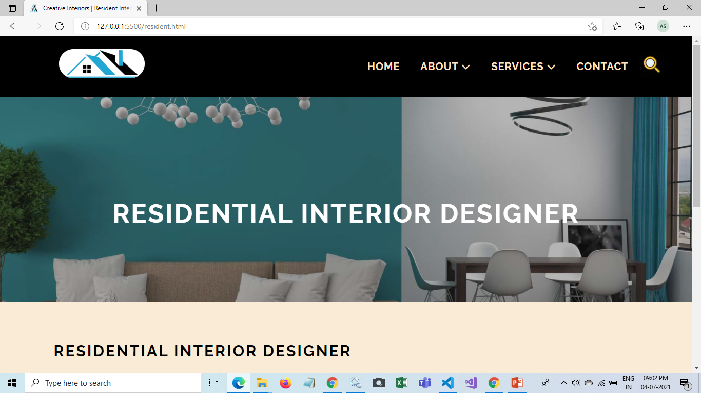
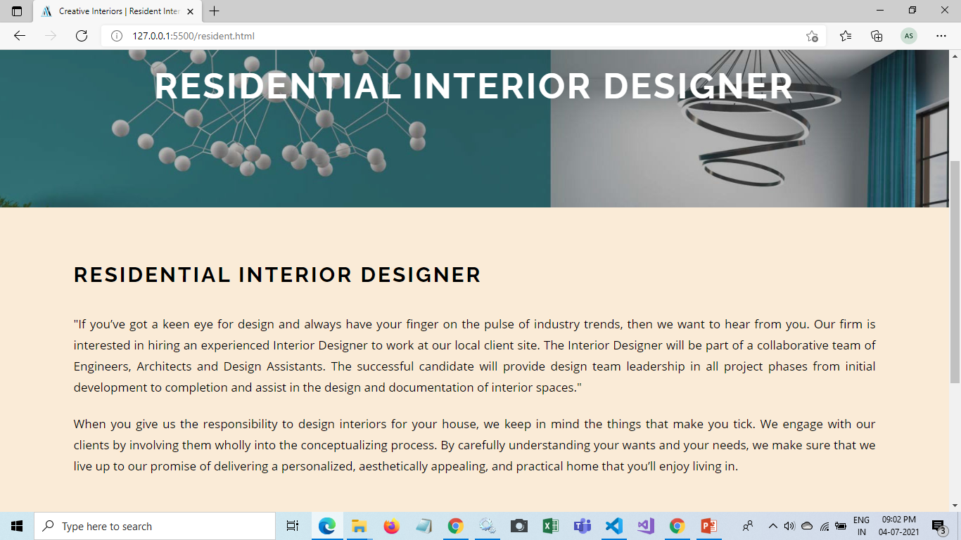
Residential Interior page

Slide 19
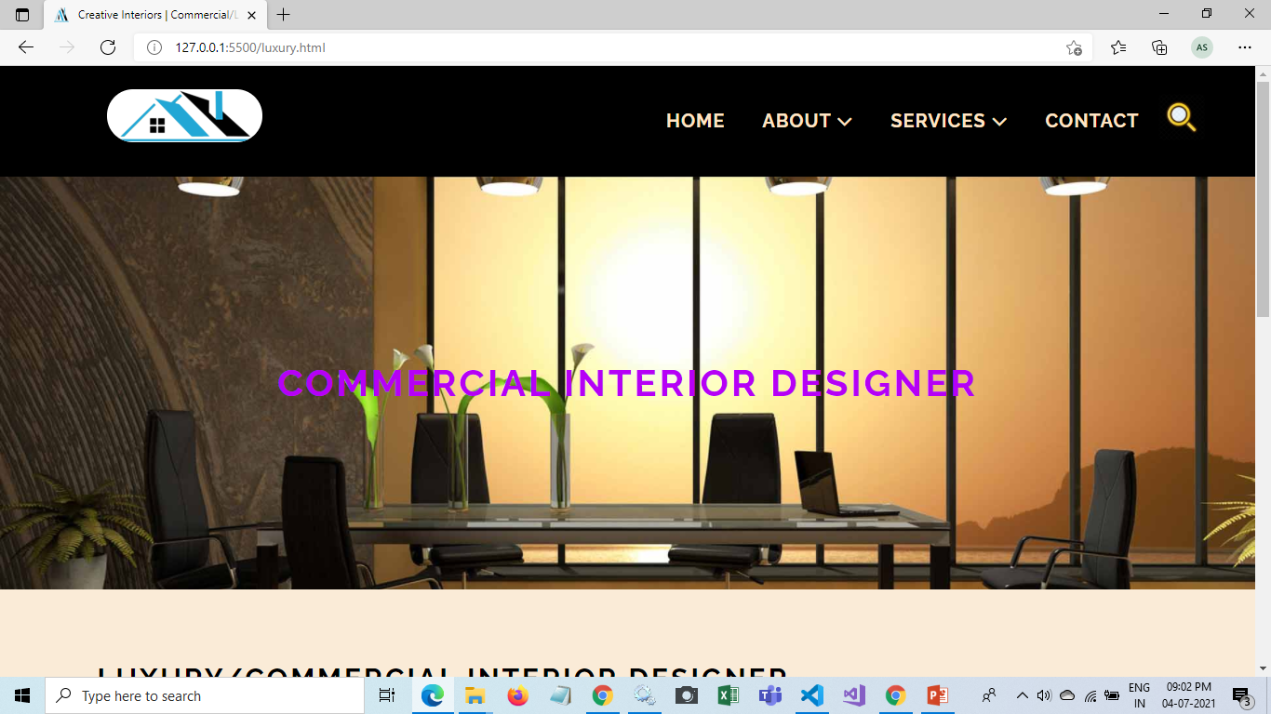
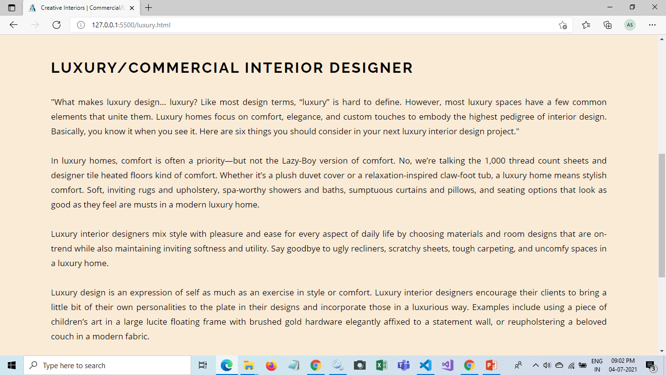
Commercial Interior page

Slide 20
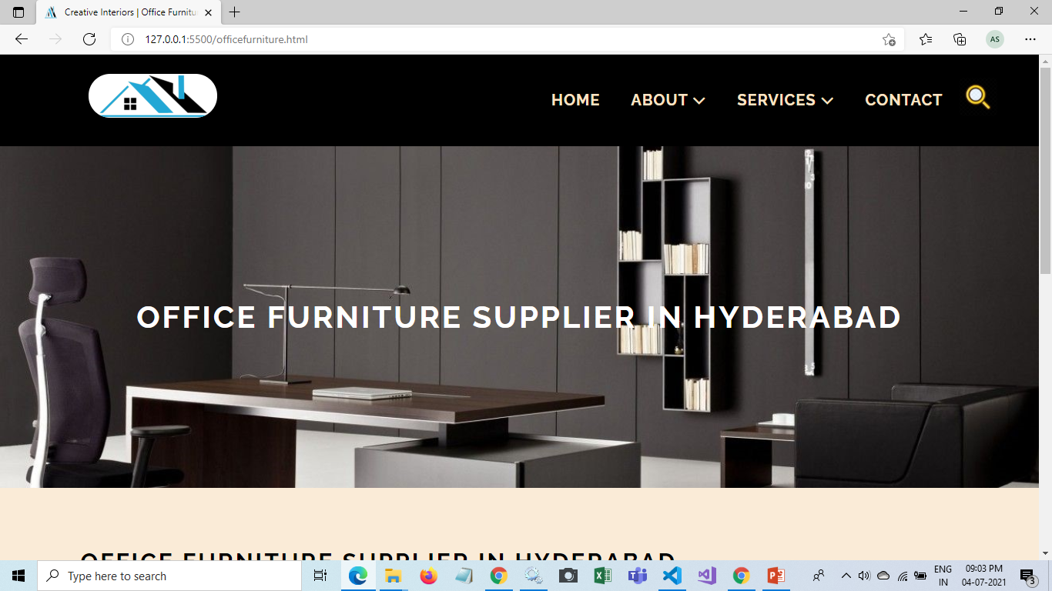
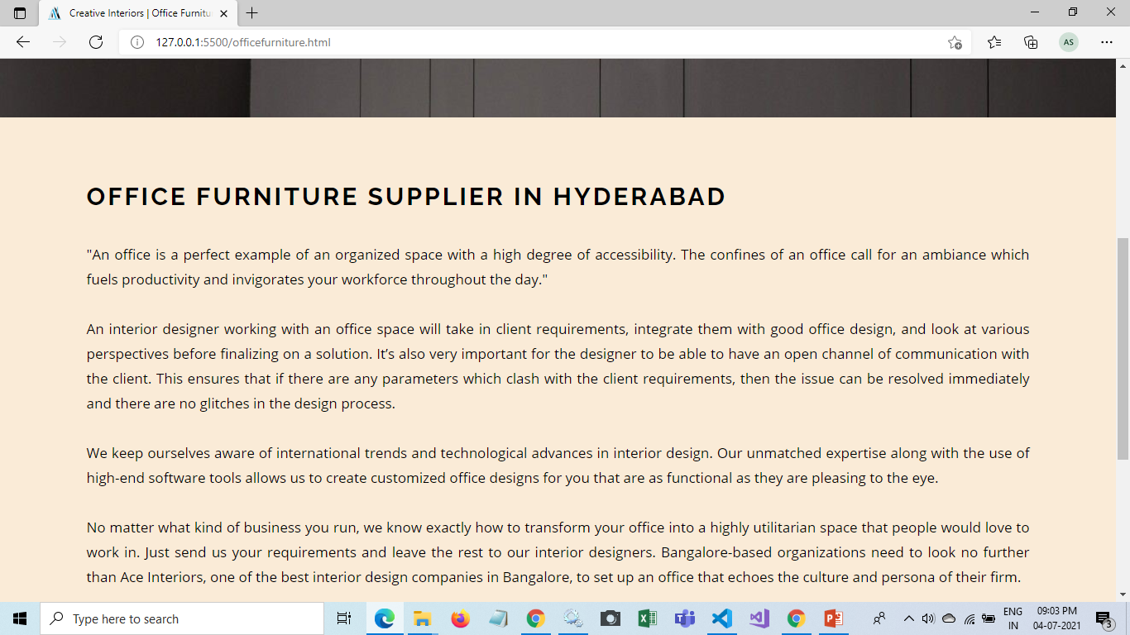
Office Furniture page

Slide 21
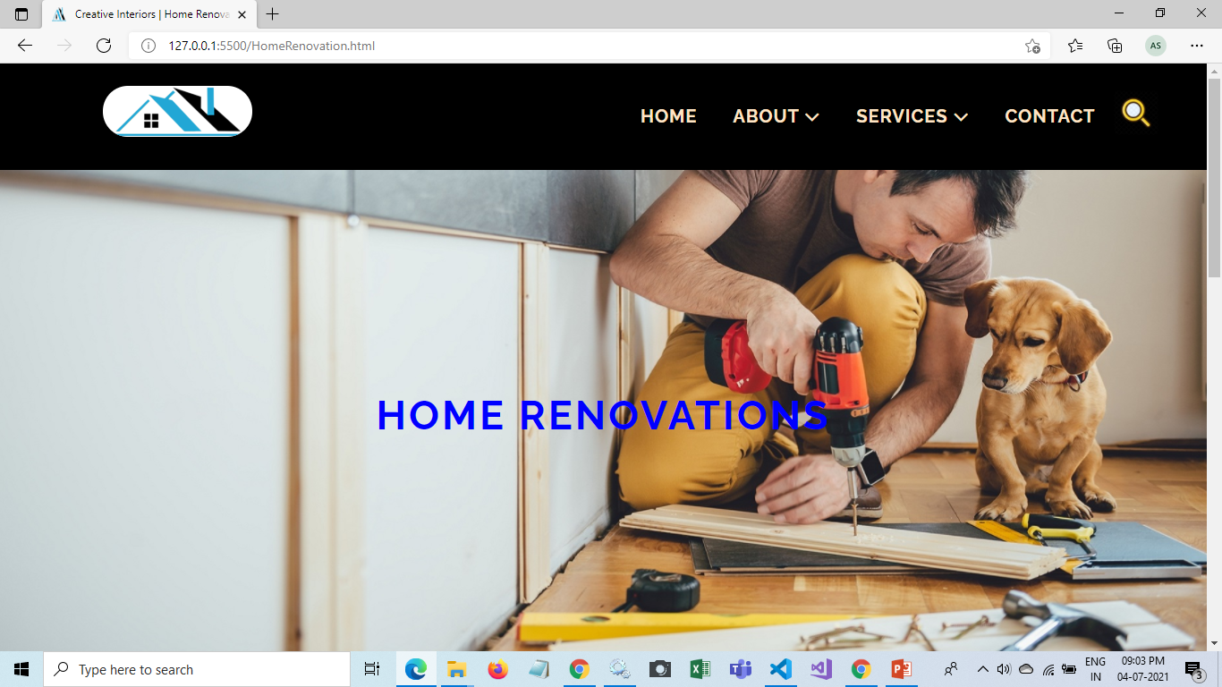
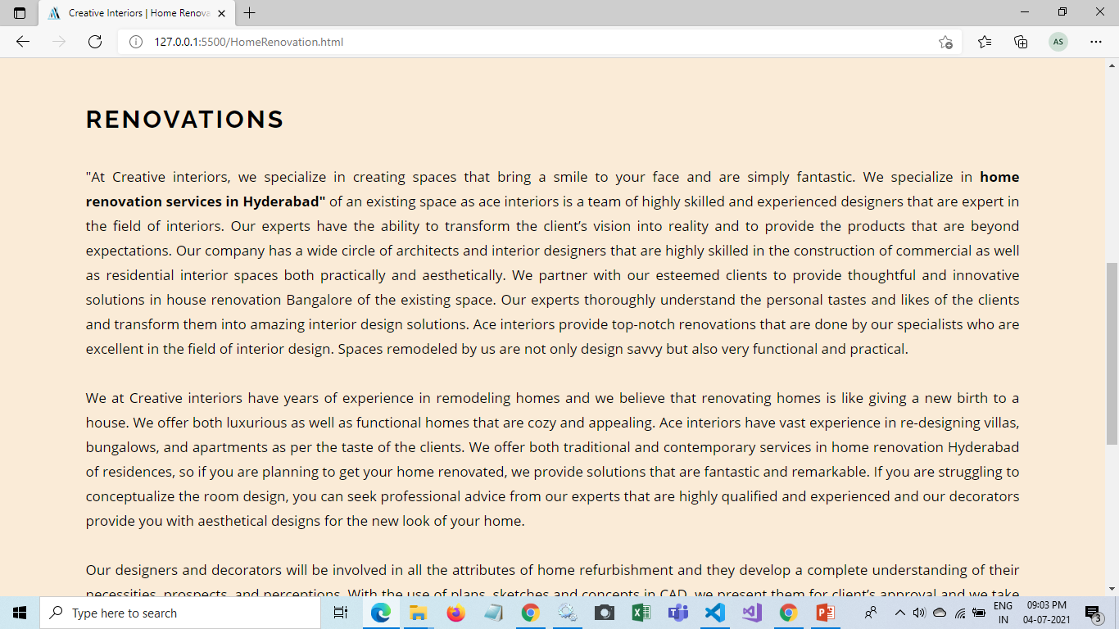
Home Renovation page

Slide 22
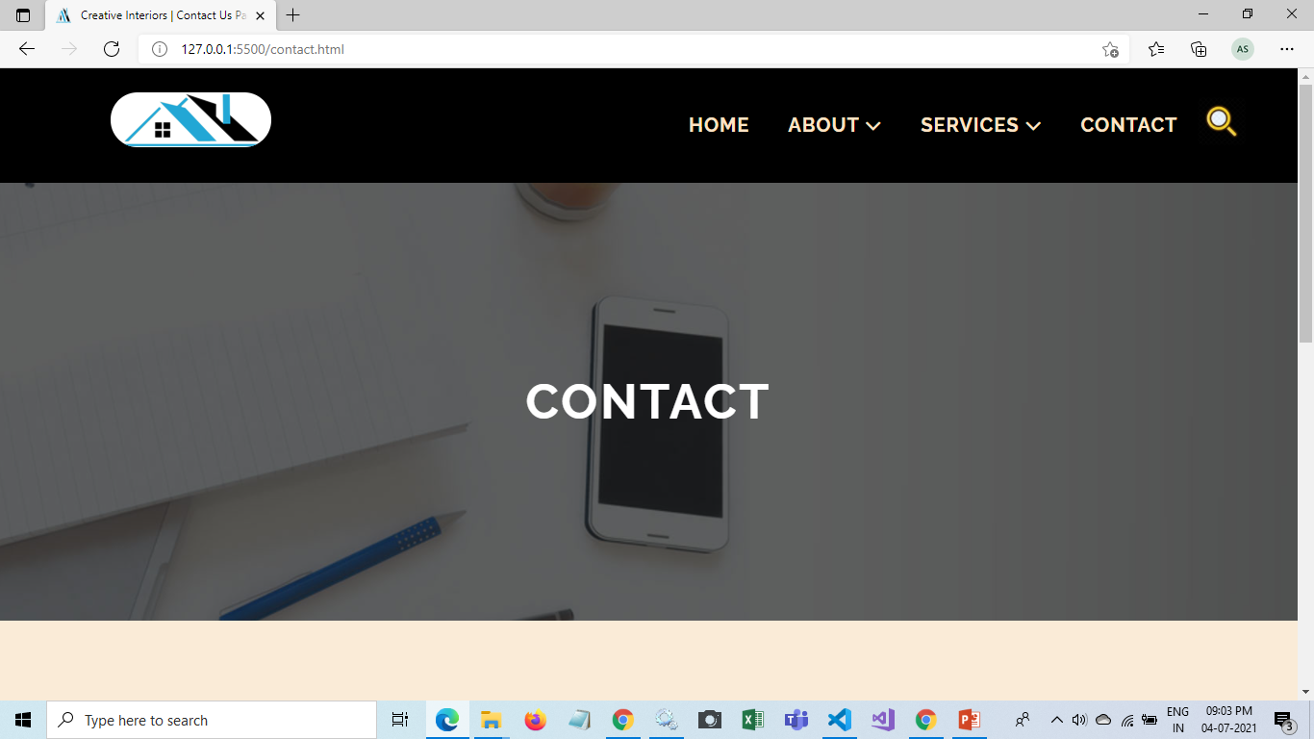
Contact Us page

Slide 23
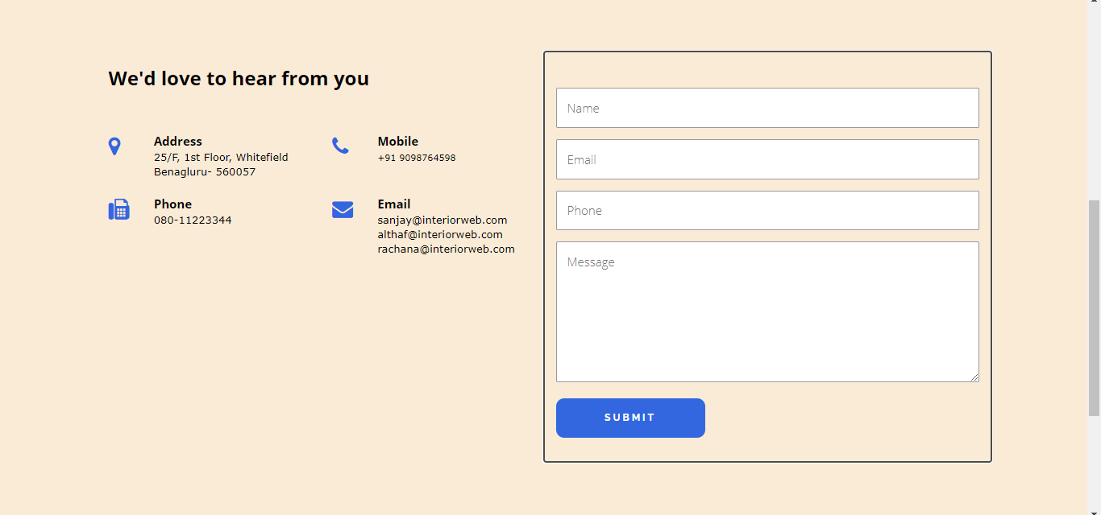
Contact Us page

Slide 24

CREATIVE INTERIORS

